Slide 1


Feature-Based Reinforcement Learning for the Rubik Cube Team Members: 1. Alisha Kareemulla 2. Thulasi Theja K S
Introduction to Artificial Intelligence

Slide 2

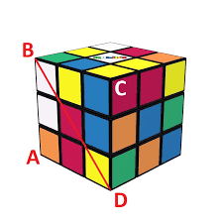
Description of Project
Create and train a reinforcement learning agent that learns to solve a 2x2x2 and 3x3x3 size Rubik cube
This is done using feature-based state representations

Slide 3

Project Objectives
Generating the initial cube and scrambling it randomly every time.
Creating a RL agent that can solve 2x2x2 and 3x3x3 rubric cube.
Training the agent based on the state of the cube using Reinforcement learning algorithms and comparing them.

Slide 4

Approach
Creating the rubric cube design for 2x2x2 and 3x3x3 using Python and its modules.
Creating an agent that can solve the cube.
Training the agent based on the state of the cube.
Reinforcement learning algorithms i.e., Deep Q-Learning and SARSA is used.
The reward system primarily focuses on the number of entirely-correct blocks / current state based on the algorithm.

Slide 5
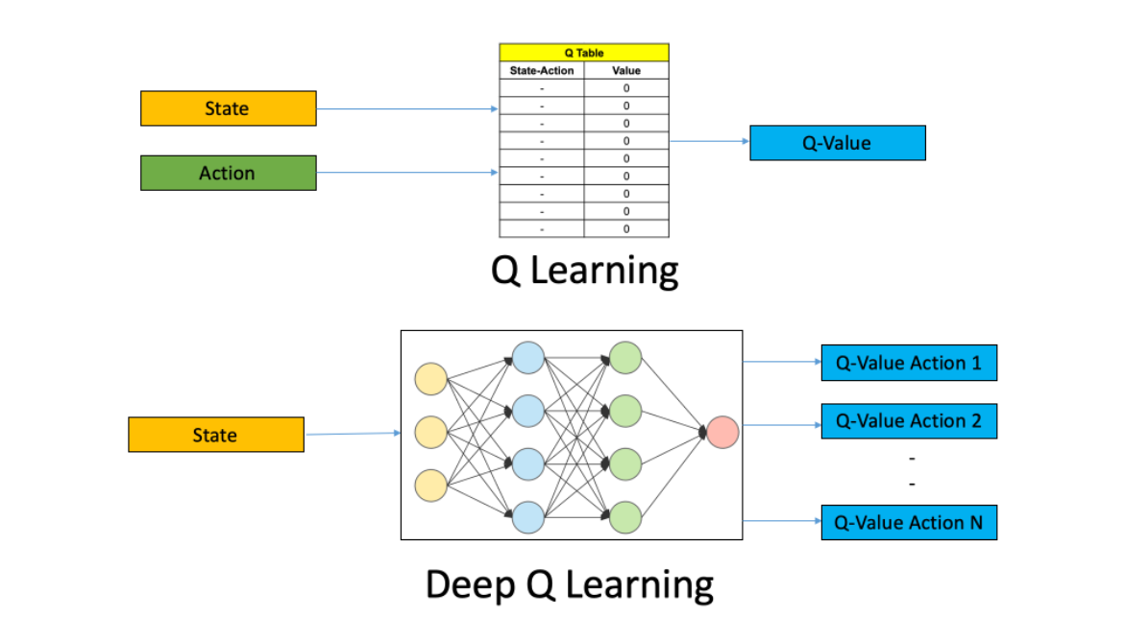
Deep Q-Learning
Involves Agent-> a
set of states-> S
set of Actions per state-> A
reward, r
epsilon
Discount factor, gamma -> probability to succeed at every step -> between 0 and 1

Slide 6
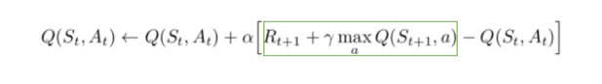
Procedure
All the past experience is stored by the user in memory.
The next action is determined by the maximum output of the Q-network.
The loss function here is mean squared error of the predicted Q-value and the target Q value – Q*.
However, we do not know the target or actual value here as we are dealing with a reinforcement learning problem.
The Q-value update equation derived from the Bellman equation

Slide 7
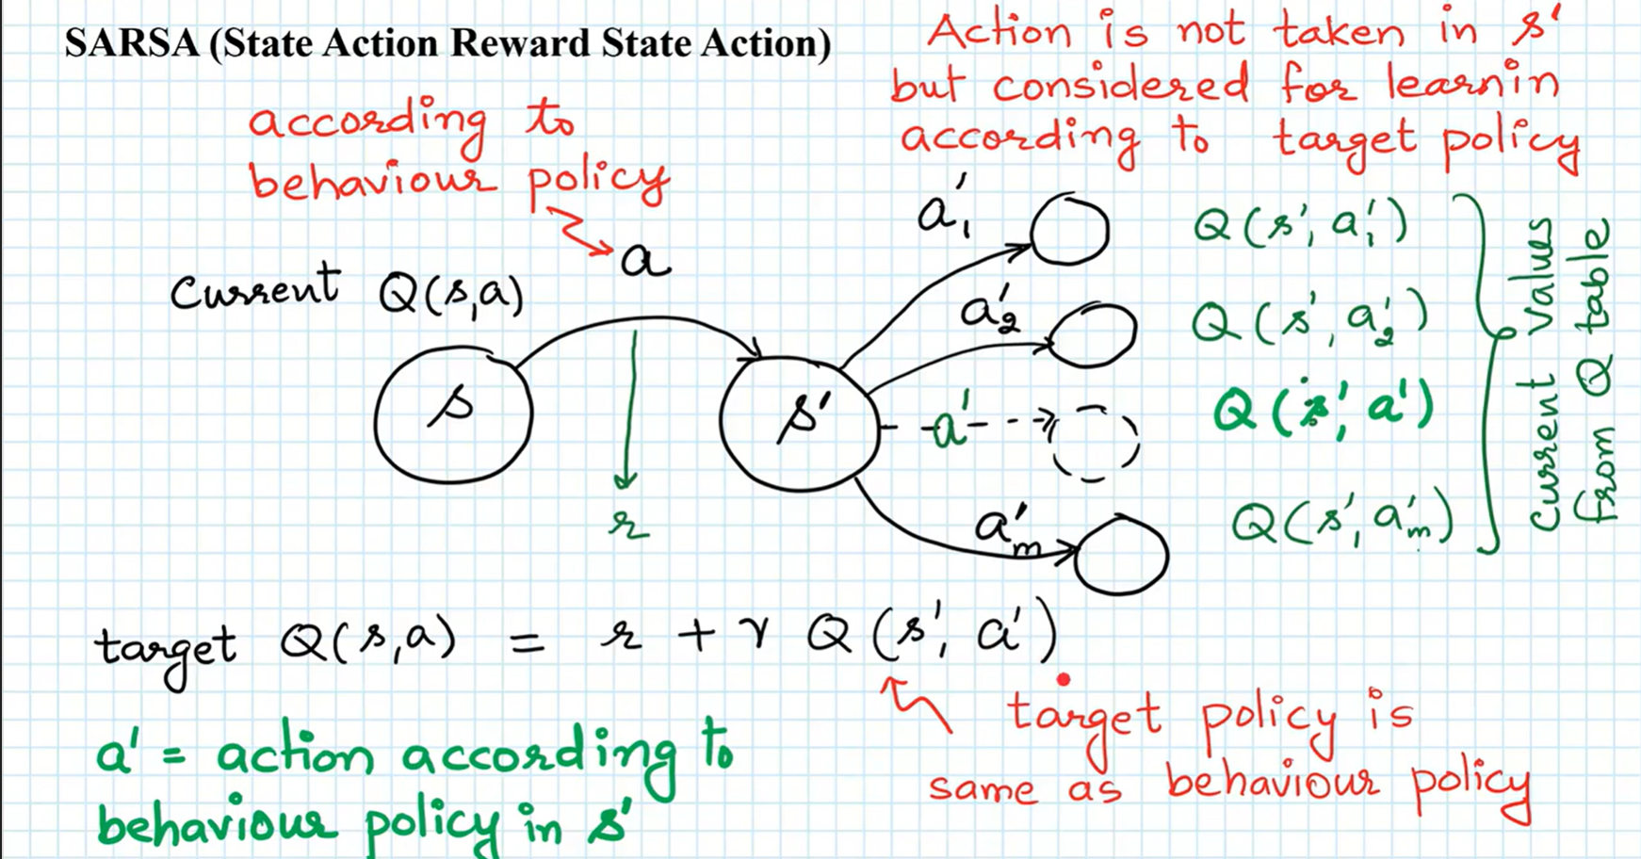
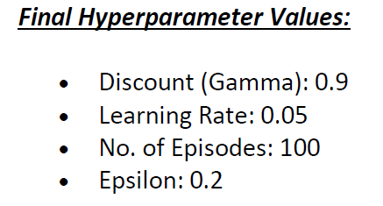
SARSA
State–action–reward–state–action (SARSA) is an algorithm for learning a Markov Decision process policy.
Agent interacts with the environment and updates the policy based on actions taken, hence this is known as an on-policy learning algorithm

Slide 8
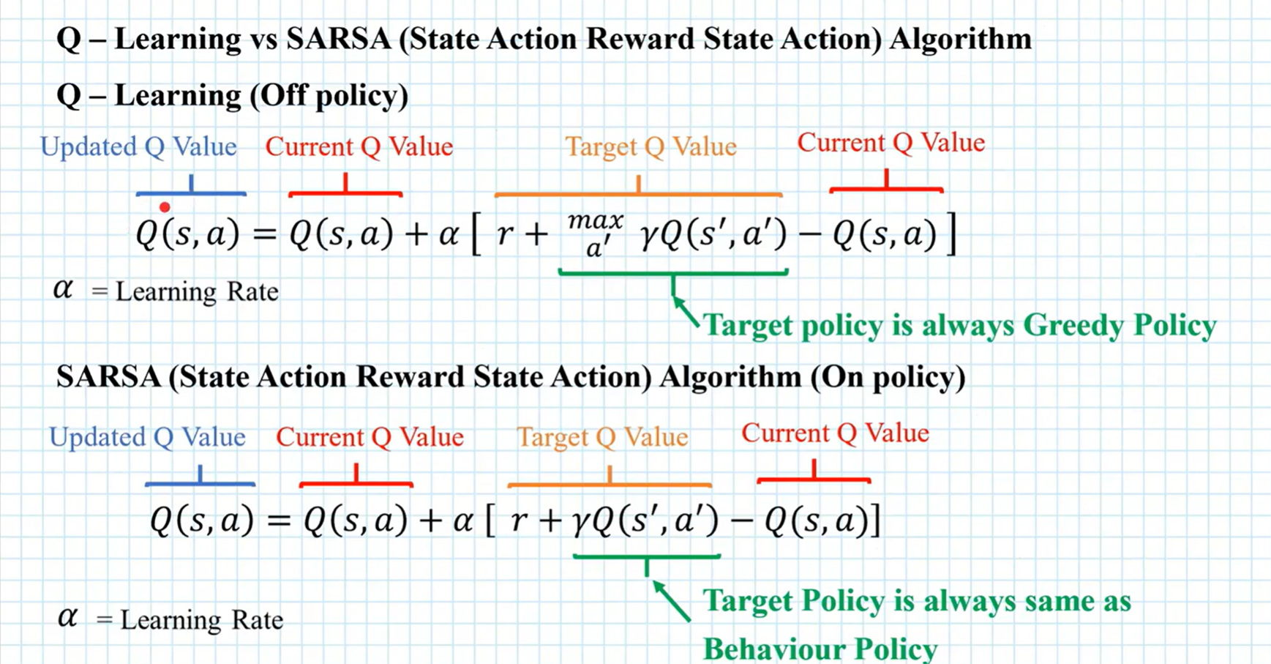

Slide 9
Code Review

Slide 10
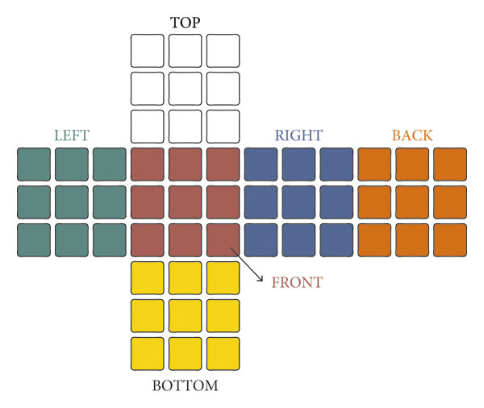
Cube Representation

Slide 11
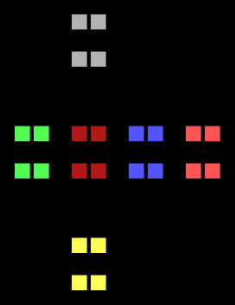
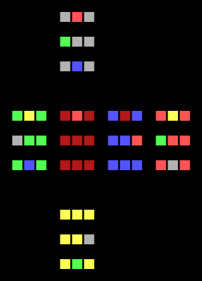
Deep Q-Learning Stats
24 solved cubes in 45 min of training
2x2x2
38 solved cubes in 3.5 hours of training
3x3x3

Slide 12
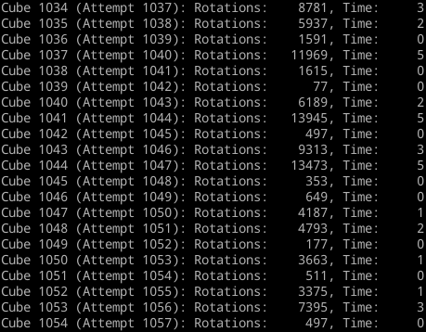
2x2x2 cube stats after 45 minutes of training

Slide 13
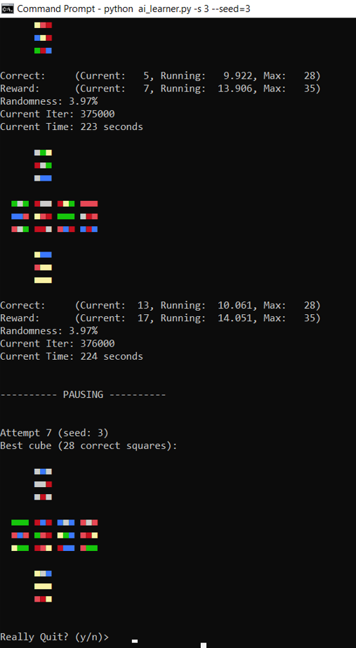
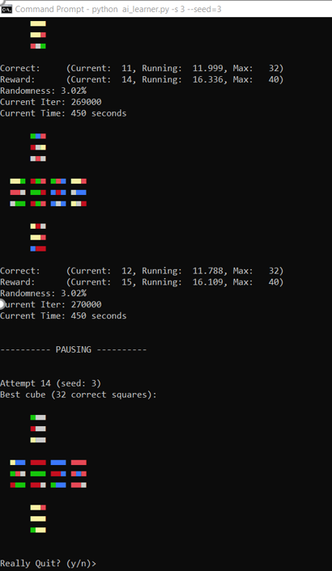
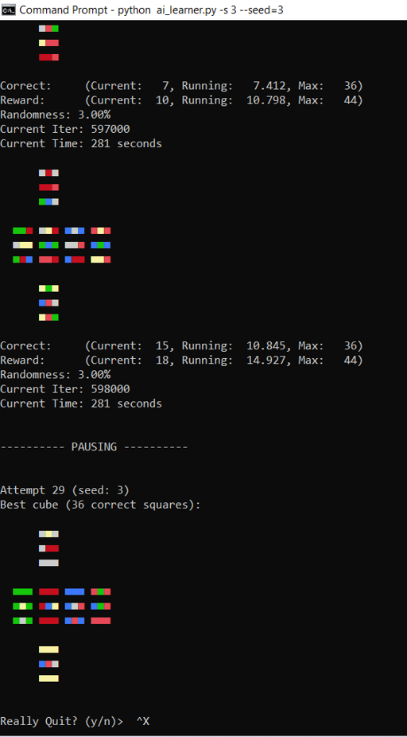
28 squares 32 squares 36 squares

Slide 14
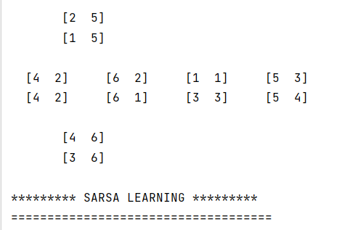
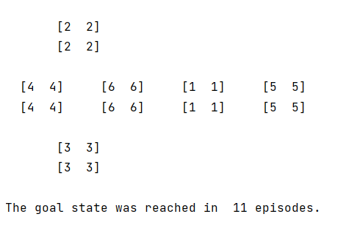
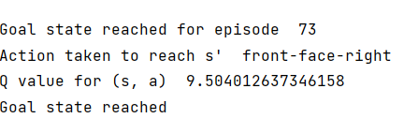
SARSA Stats

Slide 15

Deliverables
Documentation Report (README.md)
Python programming files (.py files) and the test results of the project.
GitHub repository link
YouTube video of the developed project

Slide 16

Evaluation Methodologies
The success of the project is determined by the successful implementation of the RL algorithms Q-Learning and SARSA.
The agent must be able to successfully solve the cube to its initial position or must be able to solve most of the pieces.
SARSA is preferable over Q-Learning to minimize errors which is shown from the above statistics.

Slide 17
Thank You

